Slide 1
Office 365
FREE Microsoft Office, online storage, Email, Calendars, and more

Slide 2
Objectives
FREE Microsoft Office and Cloud Storage
Single Sign On
Appropriate email Use (not private)

Slide 3
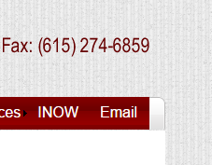
Login and email address
Single sign on
When you log into the computer you are logged into your email account
Applies at school only (use Google Chrome)
Always log off the computer
Never share your account
Why is this so important?

Slide 4
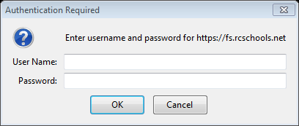
Your email address is your username@student.rcschools.net
jdoe1234@student.rcschools.net
To access your email from somewhere other than school
Email.rcschools.net
You will have to enter your username and password

Slide 5
Corporate email account
What that means
Not a personal account
Not private
School officials can access your account at any time
It is monitored and filtered

Slide 6
Appropriate email usage
Teachers and classmates (pertaining to classes)
Guidance counselors
Universities and colleges
Coaches, club sponsors
Accounts remain active until you graduate or leave the system

Slide 7
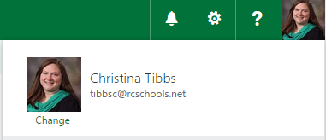
Disciplinary Action
Inappropriate use of email will result in disciplinary action
Words, content, and topics are filtered
If something gets flagged the district will see it but not the person you sent it to
You can change your profile pic, must be appropriate
This is not your facebook or twitter account

Slide 8
Inappropriate email
If you do get something
Inappropriate
Spam
Uncomfortable
Forward
help@rcschools.net

Slide 9
OneDrive
You have cloud storage in your email
It is monitored for content

Slide 10
How to use office 365
Scan the qr code in your brochure to download the manual

Slide 11
Office 365 important features
What can you do in office 365

Slide 12
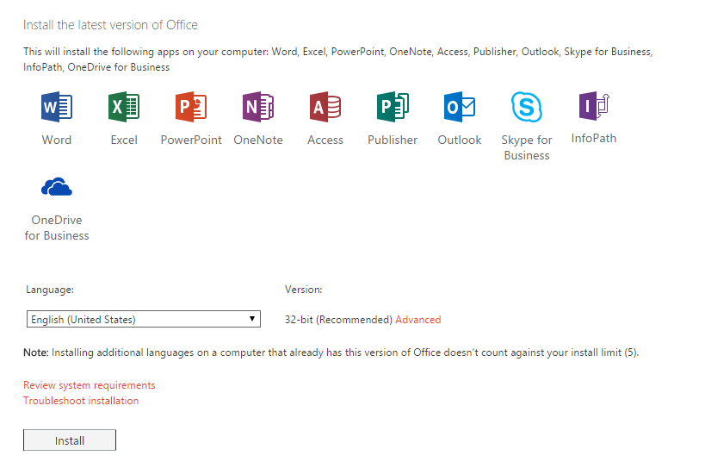
Free Microsoft office
Download Microsoft office on five devices

Slide 13
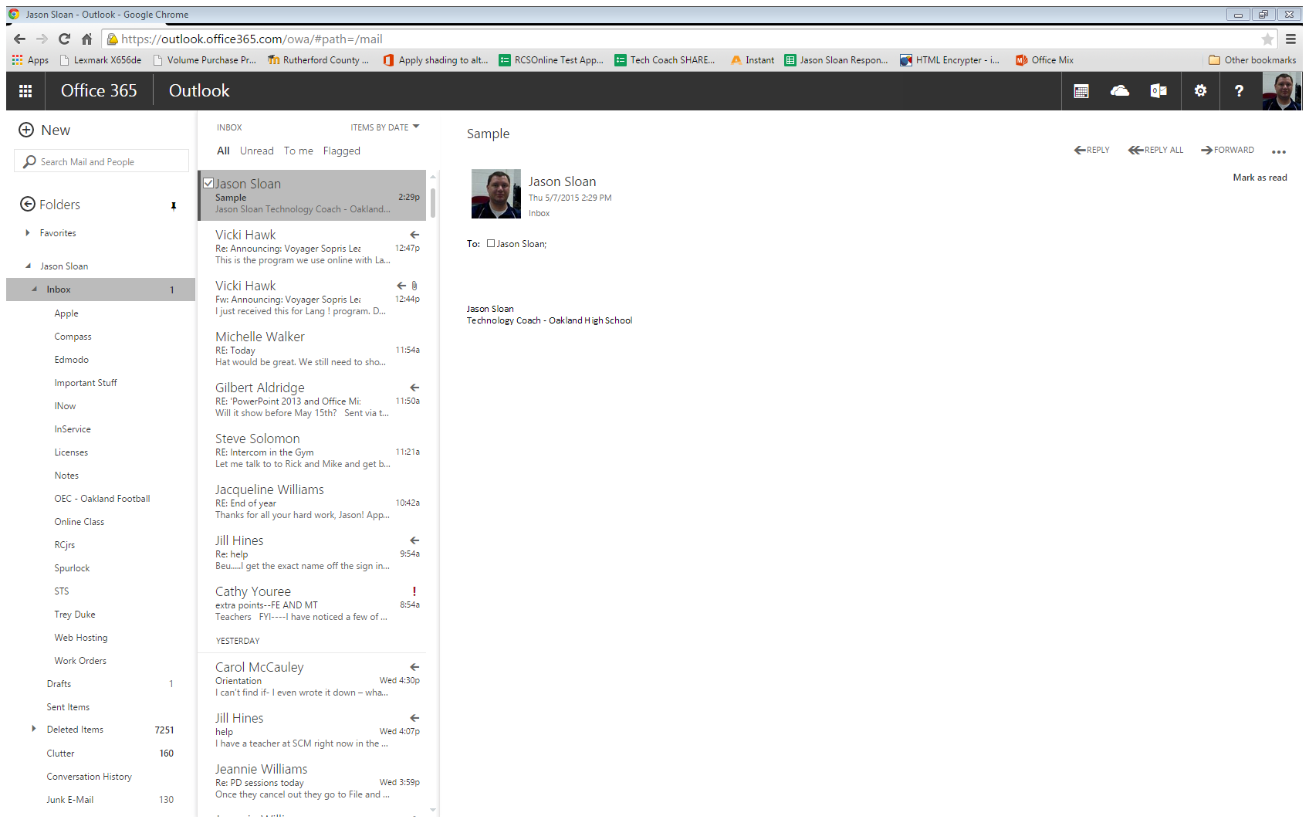

Slide 14
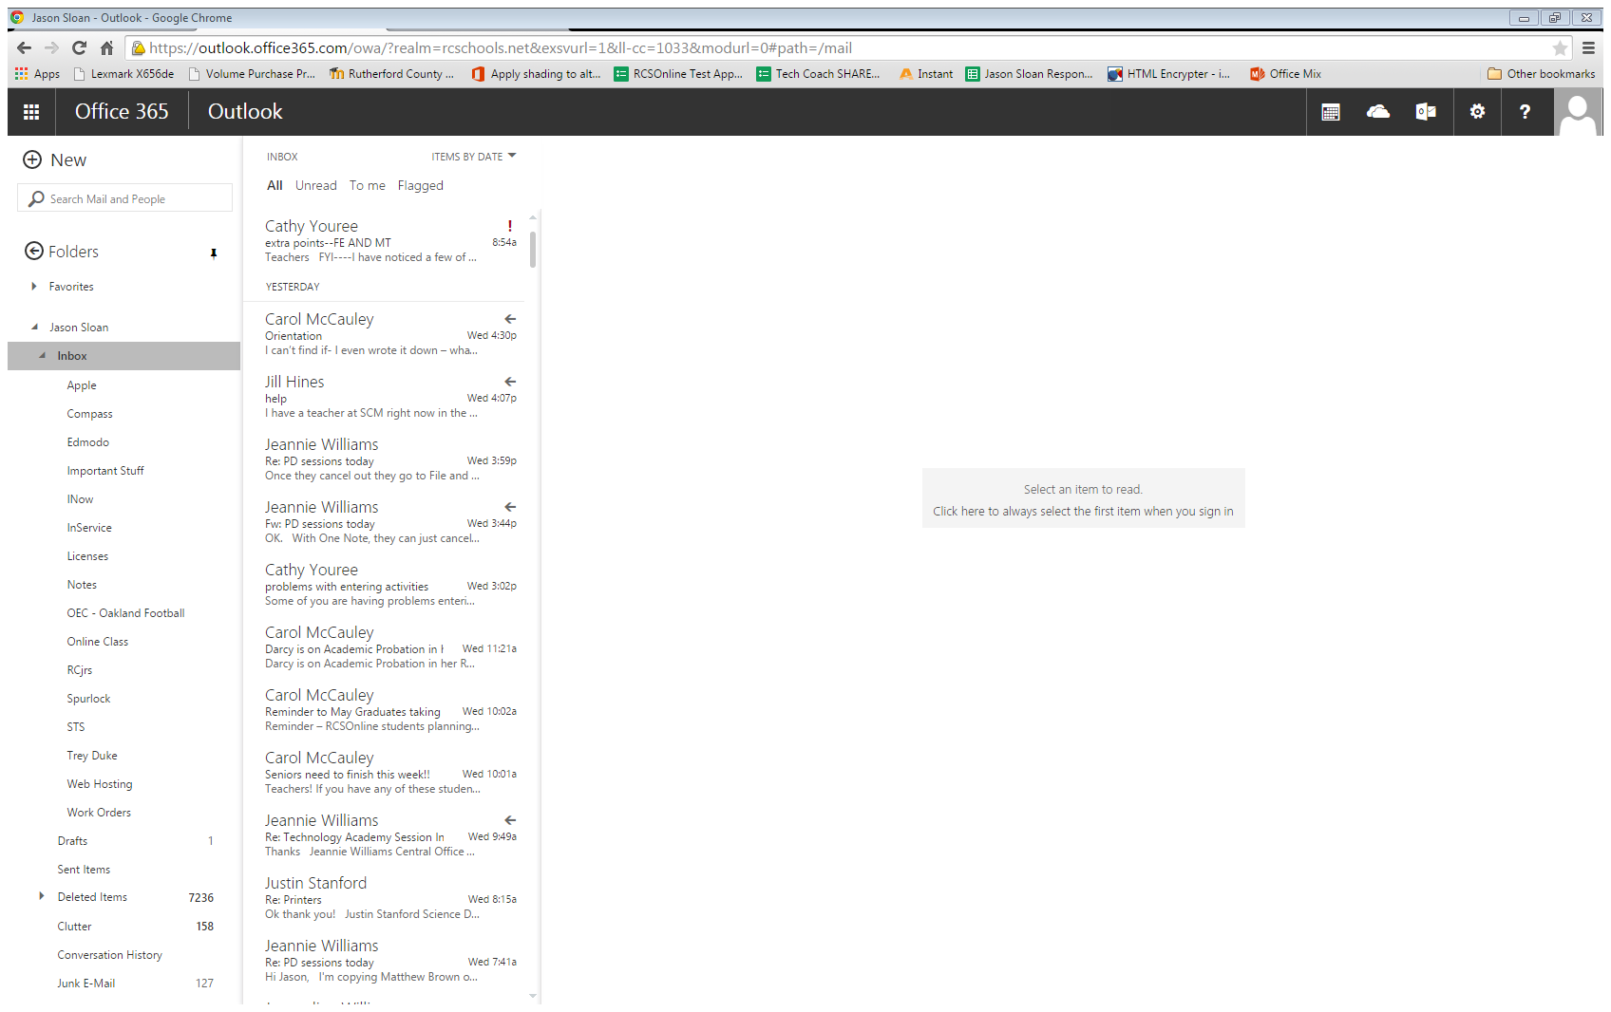

Slide 15
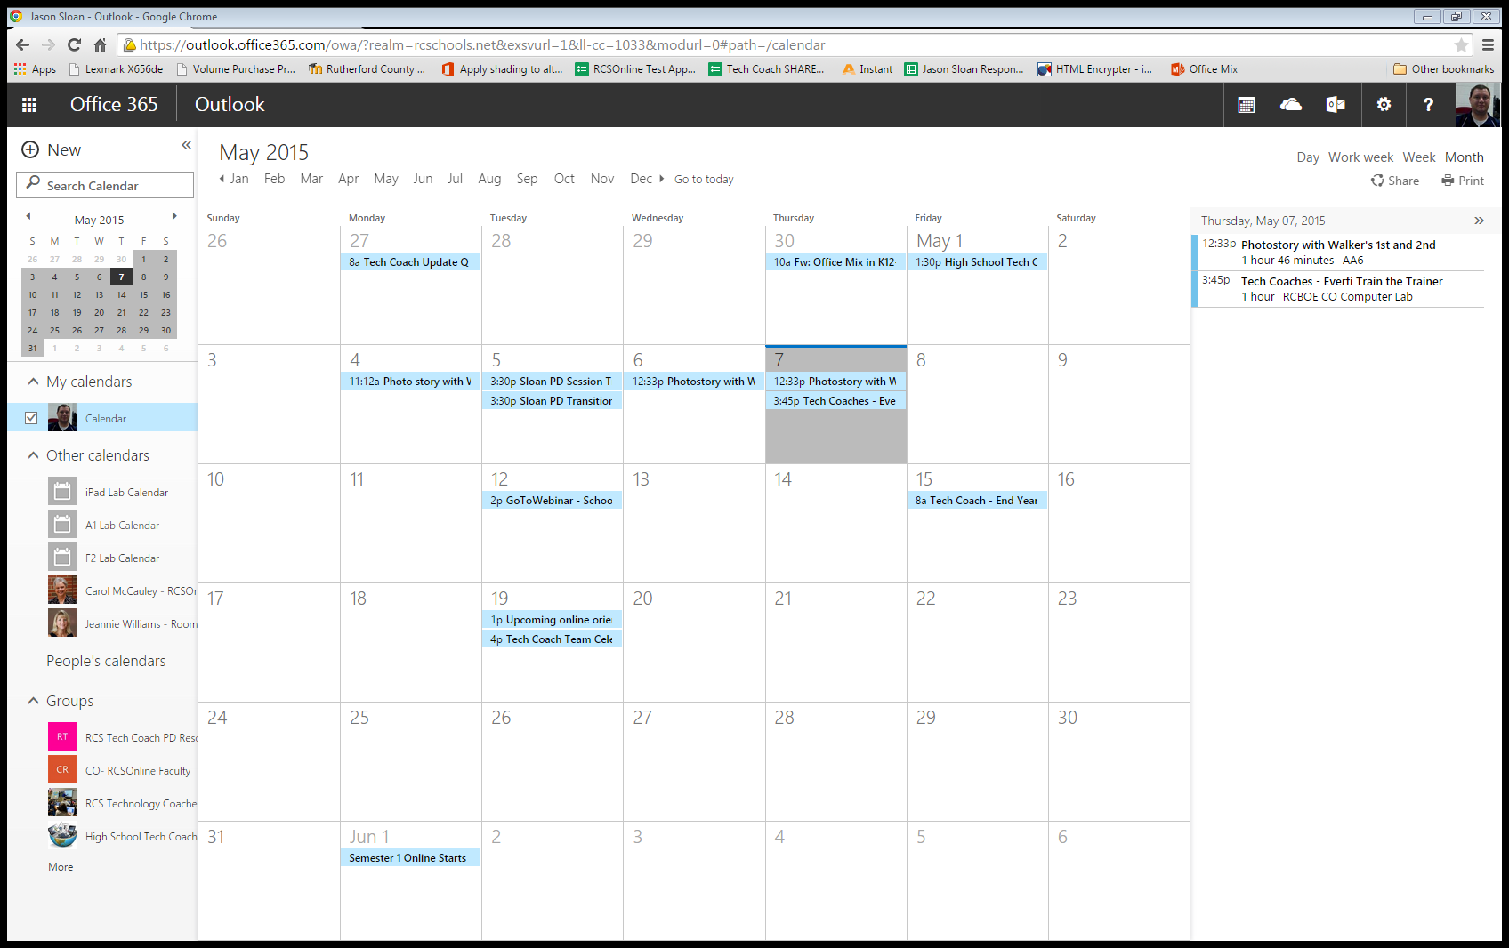
Create appointments
Your appointments will sync with your mobile device
Teachers can attach files to events they share with you
Teachers can share calendars with you

Slide 16
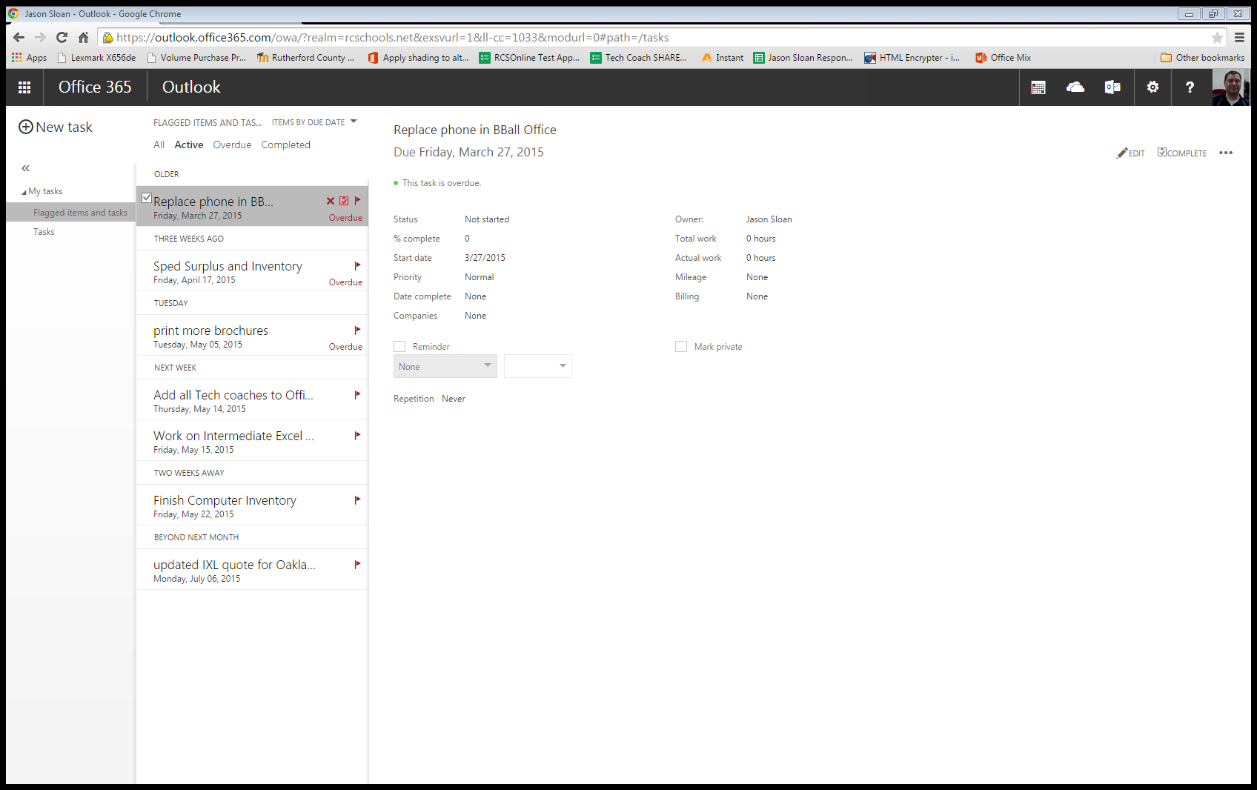
Add tasks to help you keep up with everything you have going on

Slide 17
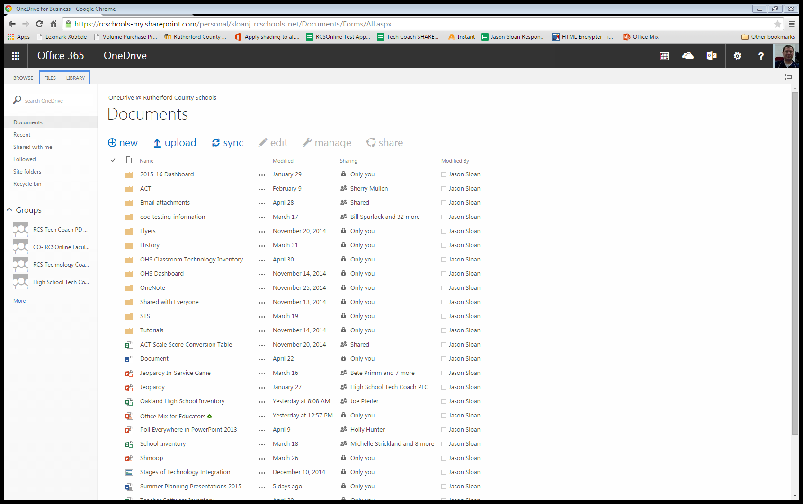
Once your files are in the cloud, they are always accessible. Even at home.
Share files with people and have them share files with you.
Remember! When you share a file as can edit they can do anything to the file you can, including delete!

Slide 18
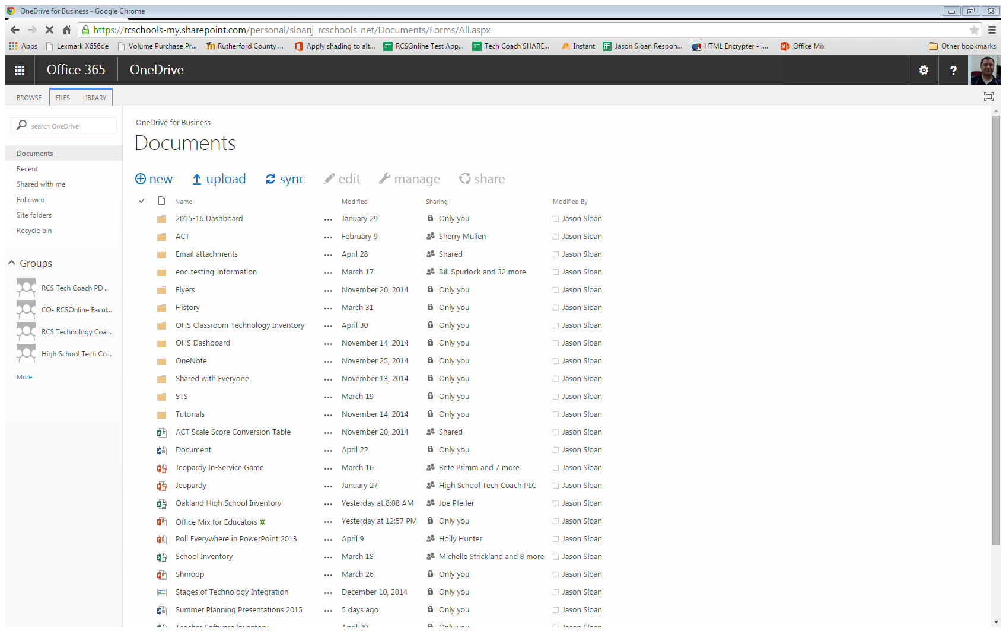
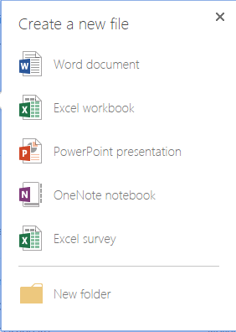
Create and edit Office files from directly within your email
OneNote allows you take notes using any device and supports handwriting
Share your files with your teacher instead of printing or emailing them

Slide 19
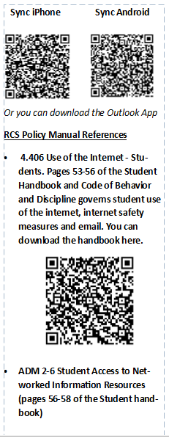
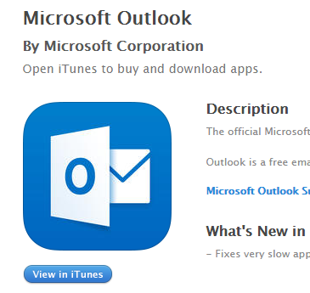
Scan the QR code to get directions to sync your mobile device

